Slide 1
Creational Patterns –Part I
Emre Kaplan, Ph.D.

Slide 2
Creational Patterns
Creational design patterns abstract the instantiation process.
They help make a system independent of how its objects are created, composed, and represented.
  A class creational pattern uses inheritance to vary the class that's instantiated, whereas an object creational pattern will delegate instantiation to another object.
Creational patterns
  Singleton
  Builder
  Factory
  Abstract Factory
  Prototype
  Twin
  Object Pool

Slide 3
Singleton Pattern
Intent
  Ensure a class has only one instance, and provide a global point of access to it.
Motivation
  One printer spooler, one file system, one window manager
Problem
  Ensure there is a single instance
  Global variable: Accessible, but single instance not guaranteed
Solution
  Make the class responsible for its instance

Slide 4
Use Singleton when
There must be exactly one instance of a class, and it must be accessible to clients from a well-known access point.
When the sole instance should be extensible by sub classing, and clients should be able to use an extended instance without modifying their code.

Slide 5
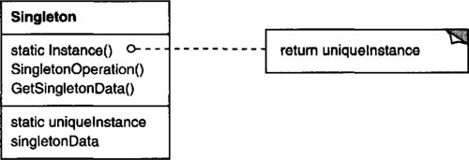
Structure

Slide 6
Participants
Singleton
  defines an instance operation that lets clients access its unique instance.
    Instance is a class operation (a static member function in C++).
  may be responsible for creating its own unique instance.
Clients access a Singleton instance solely through Singleton’s Instance operation.

Slide 7
Benefits
Controlled access to sole instance.
  Control over how and when clients access it.
Permits refinement of operations and representation by sub classing.
Permits a variable number of instances instead of one.
Notes:
More flexible than class operations.
Alternatively, package a singleton’s functionality using class operations.
But class operations are not appropriate for change.
Subclasses can’t override class operations.

Slide 8
Benefits
Improvement over global variables:
  Reduced name space.
  Global instances are always created; with Singleton, there is option to not create an instance at all.
  Singleton instantiation can be delayed to wait for runtime information.
  Order of calling constructors of global variables is not defined. Problematic if there are dependences between instances.

Slide 9
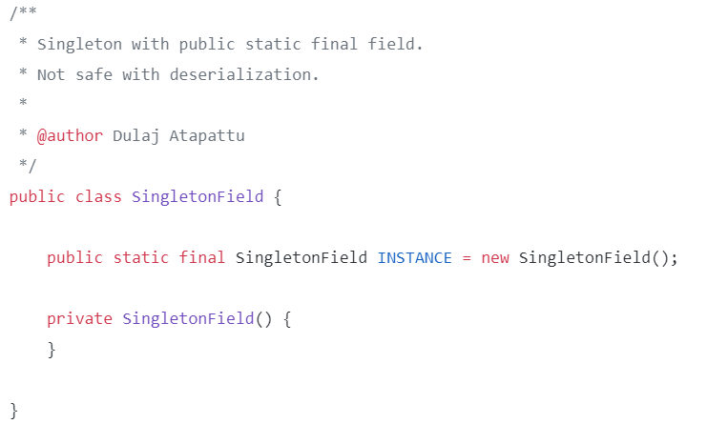
Singleton with Public Static Final Field
Source: https://medium.com/@dulajra/java-singletons-using-enum-type-the-best-method-for-making-singletons-in-java-6101048f4f31

Slide 10
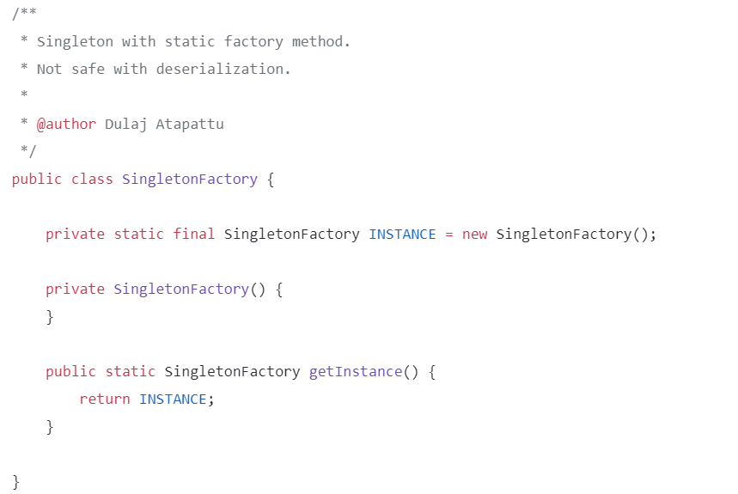
Singleton with Public Static Factory Method
Source: https://medium.com/@dulajra/java-singletons-using-enum-type-the-best-method-for-making-singletons-in-java-6101048f4f31

Slide 11
Implementation
public class SingletonDemo {
private static SingletonDemo ourInstance = new SingletonDemo();
public static SingletonDemo getInstance() {
return ourInstance;
}
private SingletonDemo() {
System.out.println("SingletonDemo is initialized");
}
public void printText(String input){
System.out.println(("input is " + input));
}
}
class Main{
public static void main(String[] args) {
System.out.println("SingletonDemo");
var x = SingletonDemo.getInstance();
x.printText("XYZ");
}
}

Slide 12
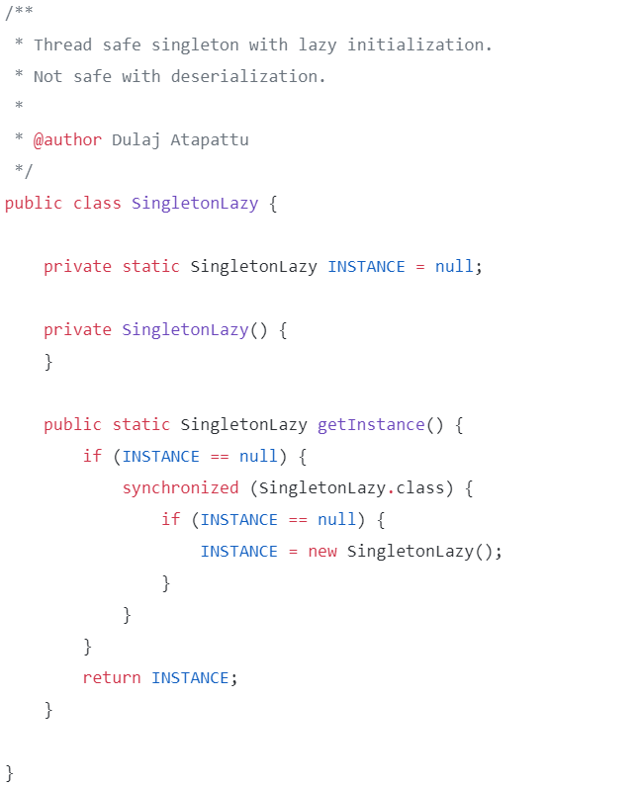
Singleton with Lazy Initialization
Source: https://medium.com/@dulajra/java-singletons-using-enum-type-the-best-method-for-making-singletons-in-java-6101048f4f31

Slide 13
Problems with Singleton
Serialization and Deserialization
  What happens if we deserialize the singleton object twice?
Reflection
  One can alter the access provider of the Singleton constructor
Constructor constructor = singleton.getClass().getDeclaredConstructor(new Class[0]);
constructor.setAccessible(true); // Make the private constructor accessible
Singleton singleton2 = (Singleton) constructor.newInstance(); // Create new instance with constructor

Slide 14
Solution: Singleton with Enum
public class EnumSingleton {
public static void main(String[] args) {
System.out.println("EnumSingleton");
SingletonObject.SINGLETON_OBJECT.setMyNum(5);
String x = SingletonObject.SINGLETON_OBJECT.toString();
System.out.println(x);
}
public enum SingletonObject{
SINGLETON_OBJECT;
private SingletonObject() {
}
int myNum = 0;
public int getMyNum() {
return myNum;
}
public void setMyNum(int myNum) {
this.myNum = myNum;
}
@Override
public String toString() {
return "mySingletonEnum num is " + getMyNum();
}
}
}

Slide 15
Builder Pattern
Builder pattern become a remedy when the increased number of object constructor parameter combination leads to an exponential list of constructors.
The intent of the Builder pattern is to move the construction logic for an object outside the class to be instantiated.
A builder, that receives each initialization parameter step by step and then returns the resulting constructed object at once

Slide 16
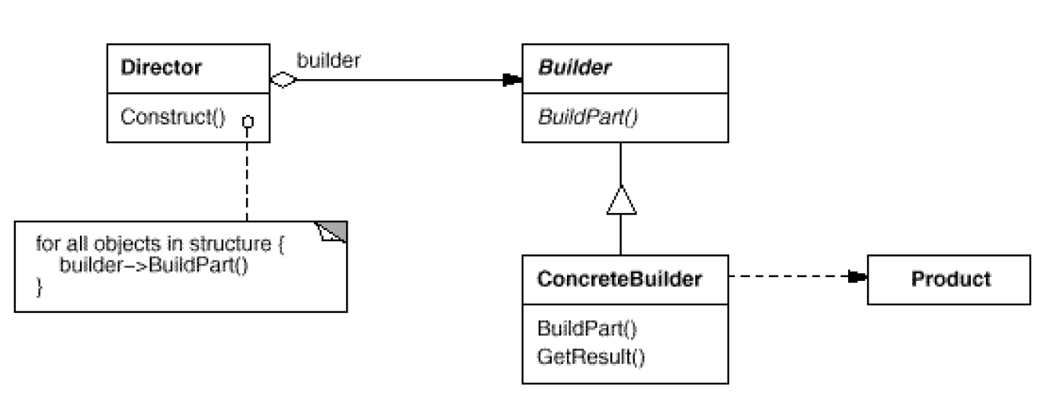
Builder Pattern
Separate the construction of a complex object from its representation so that the same construction process can create different representations.
Source: Erich Gamma, Richard Helm, Ralph Johnson, and John Vlissides. 1995. Design Patterns: Elements of Reusable Object-Oriented Software. Addison-Wesley Longman Publishing Co., Inc., Boston, MA, USA.

Slide 17
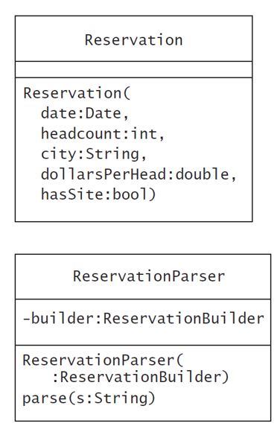
Design Reservation System
Read data from the source (parse it using ReservationParser) and create a Reservation object that represents it.
  We might approach this task by creating an empty Reservation object and setting its parameters as our parser encounters them.
  The result object may not be valid.
Ensure the validity of the objects built.
  Use builder class
The ReservationBuilder object can store a reservation request’s attributes as a parser finds them and then build a Reservation object, verifying its validity.
Source: Steven John Metsker and William C. Wake. Design Patterns in Java (Software Patterns Series). Addison-Wesley Professional.

Slide 18
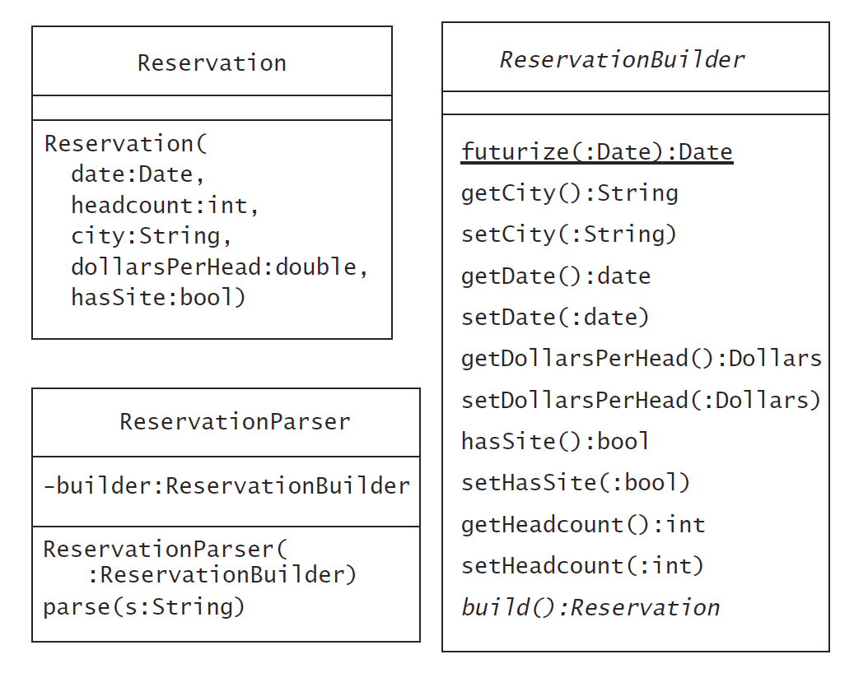
Design Reservation System
Source: Steven John Metsker and William C. Wake. Design Patterns in Java (Software Patterns Series). Addison-Wesley Professional.

Slide 19
Builder Pattern Advantages
Isolates code for construction and representation so that it makes a complex target class simpler.
  It lets a builder class focus on the proper construction of an object, leaving the target class to focus on the operation of a valid instance.
Finer control over the construction process:
  A builder also accommodates step-by-step construction, which often occurs when you create an object by parsing from a source (e.g. plain file, database, web service etc.).
Allow us to vary a product's internal representation
  The interface lets the builder hide the representation and internal structure of the product.
  The product is constructed through an abstract interface, all you have to do to change the product's internal representation is define a new kind of builder.
Source: Steven John Metsker and William C. Wake. Design Patterns in Java (Software Patterns Series). Addison-Wesley Professional.
Source: Erich Gamma, Richard Helm, Ralph Johnson, and John Vlissides. 1995. Design Patterns: Elements of Reusable Object-Oriented Software. Addison-Wesley Longman Publishing Co., Inc., Boston, MA, USA.

